Slide 1
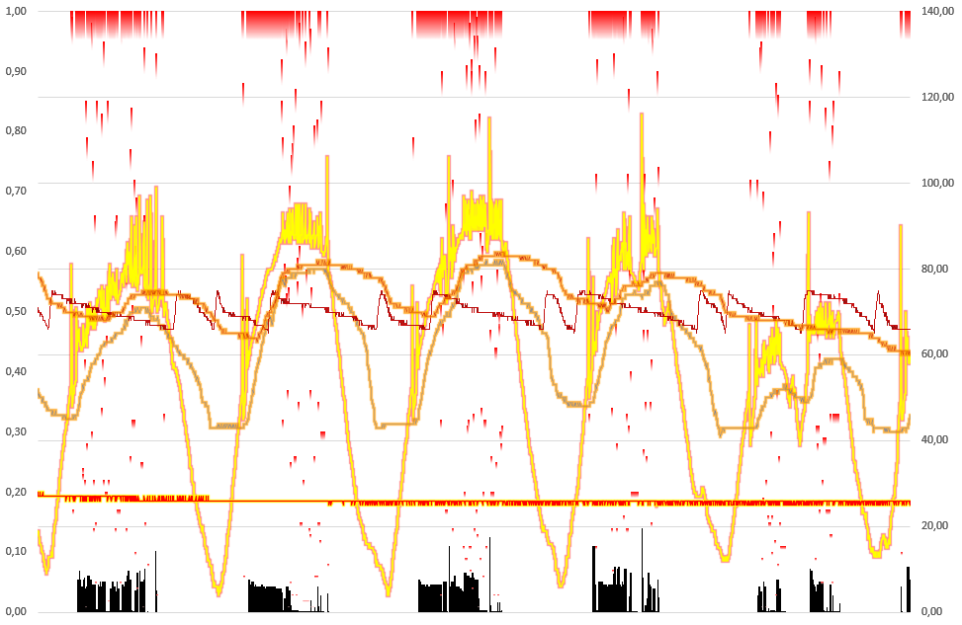
Hybrid Energy System Data
Project plan
Kimmo Valkonen

Slide 2
Content
Purpose of the Project
Current State Analysis
Project Scope
Mode Of Operation
Risk Analysis
Project Schedule
More Information

Slide 3
Purpose of the Project
Purpose of the project is to provide a Full Stack solution to collect, store and display hybrid energy system data.
Solution will be alternative for current legacy system used for collecting, storing and displaying data.
Solution will offer more flexibility for further application development.
Project will deliver better application perfomance, better error handling and logging capabilities, secure data storing and a graphical user interface.

Slide 4
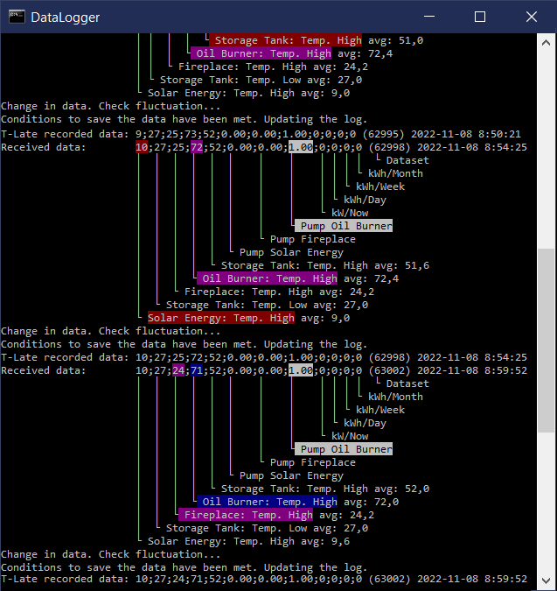
Current State Analysis
Current solution is based on Windows script executed in command shell (cmd.exe).
User can press a key to request immediate refresh the data and scroll the screen to previous records.
Script writes network, login, session and device failures to log and is able to start corrective actions depending on the type of error is in question.
Command line script has low performance.
Records are saved to .CSV file if the script can verify a real change in numbers:
2022-11-08 8:50:21;9;27;25;73;52;0.00;0.00;1.00;0;0;0;0
2022-11-08 8:54:25;10;27;25;72;52;0.00;0.00;1.00;0;0;0;0
2022-11-08 8:59:52;10;27;24;71;52;0.00;0.00;1.00;0;0;0;0

Slide 5
Project Scope
The target is to use Node.js with Express at the back end.
Back end will use cURL libraries to fetch the local Hybrid Energy System data via Internet using special Sorel connected 3rd party P2P Nabto interface.
Back end will use a database (DB) that will be able to fulfill needs. DB strategy will need to be agreed before Milestone M2.
Front end will have an interface for displaying records from the database using React.

Slide 6
Project Out of Scope
Data analysation views that are still handled with legacy Microsoft Excel templates.
Live data visualisations web page.
Hybrid system devices controlling.
Other Operating Systems than Microsoft’s currently supported Windows platforms.

Slide 7
Project Mode of Operation
Agile approach and fast switch between technologies when needed.
Prototyping Model concept used in application development adding functionalities incrementally one by one.
Application development using bottom-up strategy.
Focus on fast delivery of the 1st prototype for key user testing.
Project will use Git in version control and a private GitHub repository to store application and project data.

Slide 8
Steering group
Name | Role
Sami Ben Cheick | Project Representative
Kimmo Valkonen | Concept Owner, Configuration Owner, Principal Specialist, Key User, Full Stack Developer, Key User Network Contact during the project

Slide 9
Risk Analysis
Risk | Probability | Impact | Risk mgmt/ mitigation action(s)
Project may face problems with cURL and Nabto interface | 2 | Low | Use legacy system collecting .CSV data and convert with middleware to the database in back-end and remove the monitoring display part to gain performance.
Nabto interface service is down | 1 | High | There is no immediate mitigation actions needed if downtime will be short. Building a custom interface could be one option if Nabto downtime will be longer. In practice this would mean that the project need to cancelled.
Project delivery schedule delays. | 1 | Low | Prioritize critical deliveries and focus to deliver minimum requirements.

Slide 10
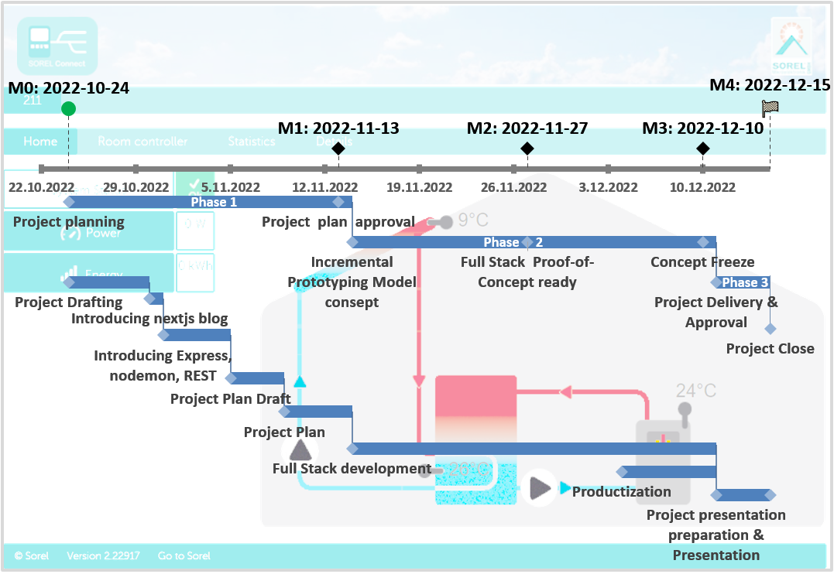
High Level Schedule Critical path of most important activities

Slide 11
More information
Sorel and Nabto: https://www.nabto.com/cases/sorel/
cURL: https://curl.se/, https://github.com/curl

